Slide 1
Machine Learning
Dimensionality Reduction in R
July 2019

Slide 2
Content
Principal Component Analysis (PCA)
The Curse of Dimensionality
Why reduce dimensionality?
Exploring multivariate data
Getting PCA to work with FactoMineR
PCA with FactoMineR
Exploring PCA()
PCA with ade4
Interpreting and visualizing PCA models
Plotting cos2
Plotting contributions
Biplots and their ellipsoids
Proximinty of variables in a 2-D PCA plot
Advanced PCA & Non-Negative Matrix Factorization (NNMF)
Determining the right number of PCs
The Kaiser-Guttman rule and the Scree test
Parallel Analysis with paran()
Performing PCA on datasets with missing values
Why is mean imputation problematic?
Estimating missing values with missMDA
N-NMF and topic detection with nmf()
Topic detection with N-NMF: Part I
Topic detection with N-NMF: Part II
Trying different N-NMF algorithms
Exploratory Factor Analysis (EFA)
Intro to EFA
EFA’s model
The Humor Styles Questionnaire dataset
Intro to EFA: Data factorability
How factorable is our Dataset?
Move on or step out of EFA?
Extraction methods
EFA with MinRes and MLE
EFA with Principal Axis Factroing
Choosing the right number of factors
Determining the number of factors
Taking the actual decision
Advanced EFA
Interpretation of EFA and factor rotation
Rotating the extracted facotrs
Which rotation method to choose?
Interpretation of EFA and path diagrams
Interpreting humor styles and visual aid
Humor Styles and hidden factors
EFA: case study
Factorability check
Extracting and choosing the number of factors
Factor rotation and interpretation
Congratulations!
When do we use each method?

Slide 3
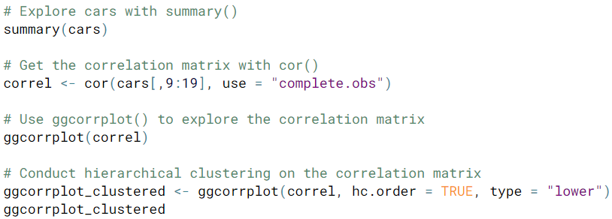

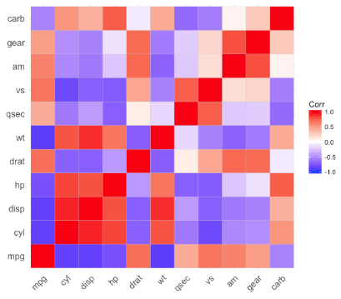

Principal Component Analysis
Dimensionality reduction methods aim to overcome the “curse of dimensionality”
obstables that hamper you from understanding the underlying structure of your data
Standard process of exploring your data
$$Data Density= \frac{total observations}{\prod_{dimension=i}^{n}{{range}_{i}}}$$
Use summary() to glimpse at your data
Construct a correlations using cor()
Visualize correlation by using ggcorrplot()
Conduct hierarchical clustering on the correlation matrix
Elements of the curse of dimensionality
as dimensionality grows, the feature space grows rapidily
bigger feature space increases computational costs
estimation accuracy decreases
data interpretability / intuition degrades
Most dimensions could probably be reduced due to a small set set of latent (uncorrelated) dimensions
Observed features obscure the true or intrinsic dimensionality of the data
A starting point for data exploration is to examine correlation amongst the various features ➔
This visualization process is difficult to interpret when trying to reduce the number of dimensions.
Approaches to dealing with the curse of dimensionality
use feature engineering: this requires domain knowledge
use dimensionality reduction techniques to remove redundancies
Principal components analysis (PCA)
Non-negative matrix factorization (NNMF)
Exploratory factor analsysis (EFA)
the idea here is to explain as much data variation as possible while discarding highly correlated variables
Principal Component Analysis

Slide 4
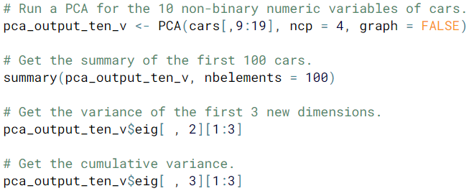
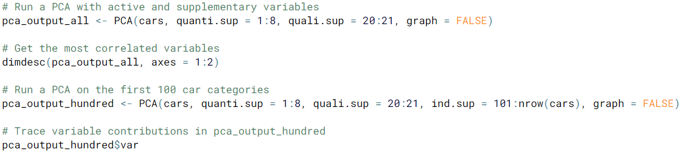
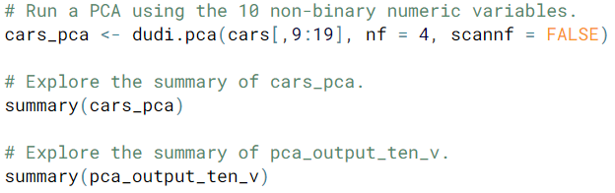
Principal Component Analysis
What does PCA do?
Conceptually | Practically
Removes correlation | Decomposes the correlation matrix
Extracts new dimensions (these are the principal components) | Changes the coordinate system
Reveals the true dimensionality of the data | Helps reduce the number of dimensions
Five steps in PCA
Pre-processing (2 steps) → centering and standardization
Change of coordinate systems (2 steps) → rotation and projection
Explained variance (reduction)
PCA Model Object
Principal Component Analysis

Slide 5
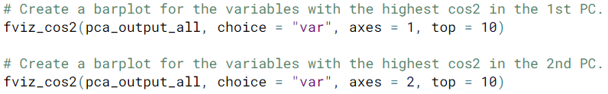
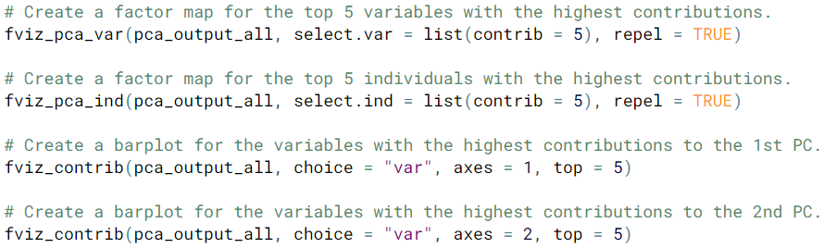
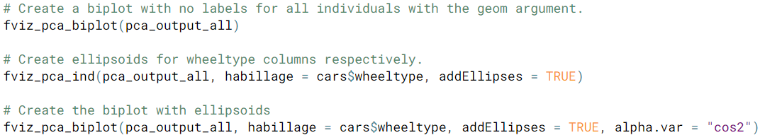
Principal Component Analysis
The factoextra package is exclllent at handle PCA models built using FactoMineR.
Now you know what it means that a variable is important in the extraction of the principal components. You could compare the two different graphs. Which variables are in both dimension very important and which ones are only in one of them?
Principal Component Analysis

Slide 6
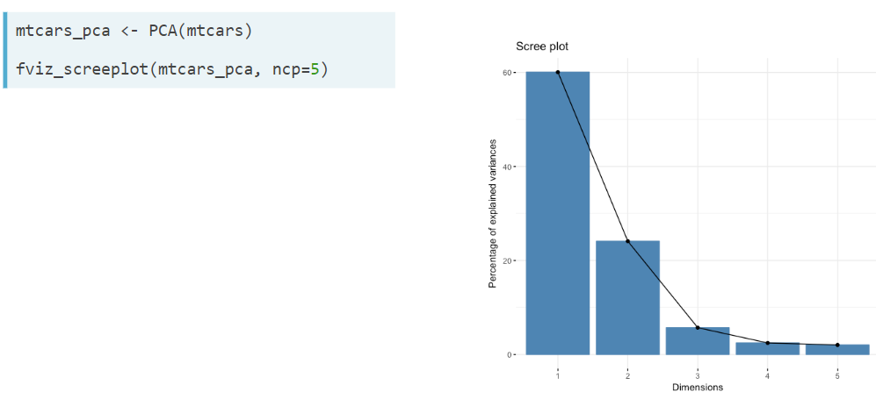
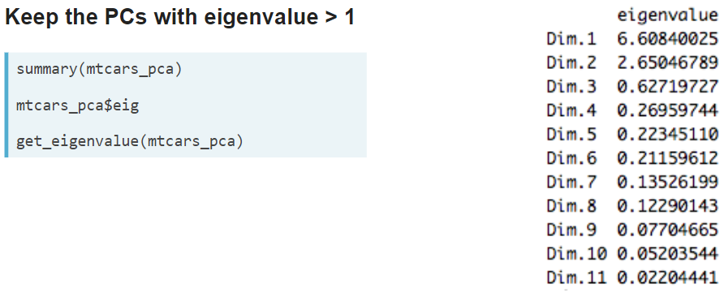
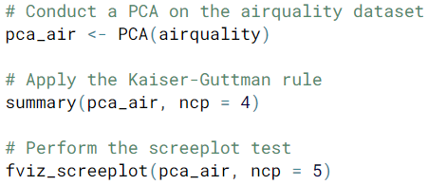
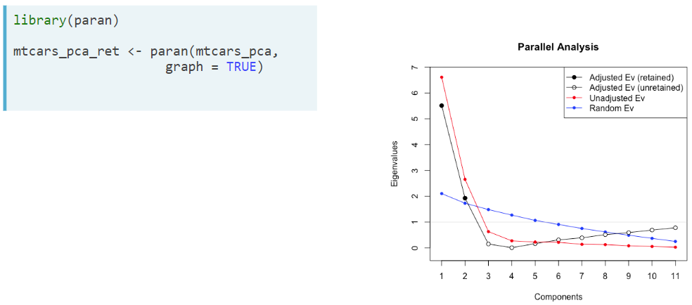
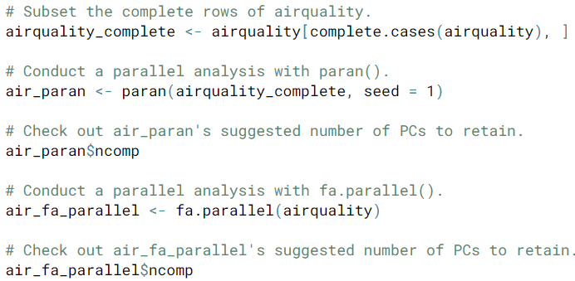
Principal Component Analysis
There are three stopping rules for PCA analysis – 1) Scree test, 2) Kaiser-Guttman rule, and 3) Parallel Analysis
Principal Component Analysis

